Slide 1
Chapter 3. Overview of Ols
Financial Econometrics
Department of financial engineering
Zhongnan university of economics and law
Xu Yonghao
2023

Slide 2
oUTLINE
Overview of OLS
An Example
Event Study Intro
FAQ of OLS

Slide 3
1 overview of ols
“explaining y in terms of x,” or in “studying how y varies with changes in x.”
Does such effect exist? How? To what extent？
Specifically
estimating economic relationships
Effect of education on wages
testing economic theories
CAPM, what is x, what is y? and more
evaluating government and business policy
Does the cut of benchmark interest rate increase stock market return?

Slide 4
1 overview of ols
Three problems with the simple task
since there is never an exact relationship between two variables, how do we allow for other factors to affect y?
Wage depends on many factors, including education
what is the functional relationship between y and x?
Positive correlated, but linear or nonlinear?
how can we be sure we are capturing a ceteris paribus relationship between y and x (if that is a desired goal)?
All else equal，what is the relation between x and y?
A simple equation to explain y in terms of x is
where u is a random variable uncorrelated with x

Slide 5
1 Summary Statistics
Three problems can be solved in this equation
to handle the problem 1： error term
The joint effect of all other factors
to handle problem 2: linear relationship:
meaning: a one-unit change in x has the same effect on y, regardless of the initial value of x.
3. Problem 3, Ceteris Paribus assumption
partial derivatives explanation: Meaning of the assumption -> partial derivatives
To assure such assumption, partial derivative of u over x should be zero! E(u|x)＝0
economic interpretation
endogeneity

Slide 6
1 overview of ols
What if linearity does not satisfy?
taylor expansion
What if E(u|x) does not equal 0?
Actually, it is impossible to assume that if E(u|x)=0
Considering adding control terms.
Therefore, Multiple regression model
Notes:
1 要求u与x独立，即所有的其它影响y的因素不能与x相关，几乎是不可能的
2在这种情况下，我们需要把那些相关的因素考虑进来。比如学习成绩与学习时间

Slide 7
1 overview of ols
Interpreting the Regression Equation
The b1 and b2 have partial effect, or ceteris paribus, interpretations.
E(y|x1,x2) is partial derivative of x1(xk)
i.e., Y=wage X: x1 education, gender, IQ
If x1 and x2 are related, what is the partial effect?
Even if x1 and x2 are statistically correlated, but we can still study two people/observation: with the same x2, but different x1.
If we put x2 to u, then we cannot have partial effect to analyze the effect of x1 on y.
In the model 3.6, the betas are not specified, and therefore we need to estimate the results using Python (or stata) and actual data.

Slide 8
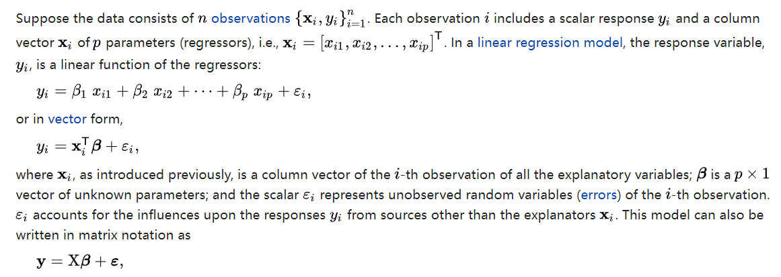
1 overview of ols

Slide 9
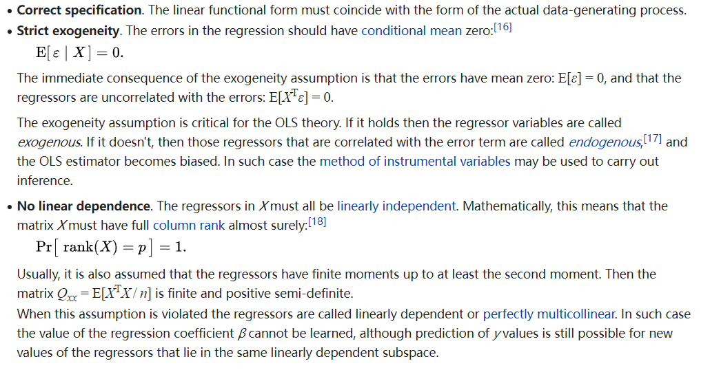
1 overview of ols - ASSUMPTION

Slide 10
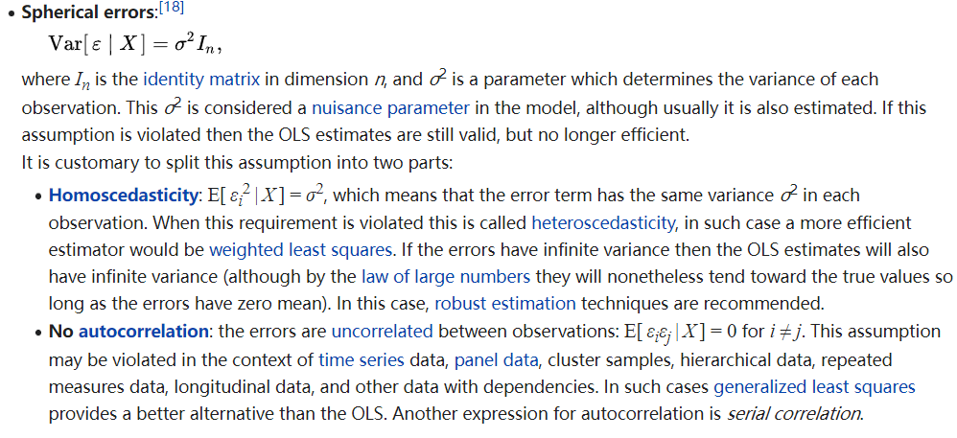
1 overview of ols - ASSUMPTION

Slide 11
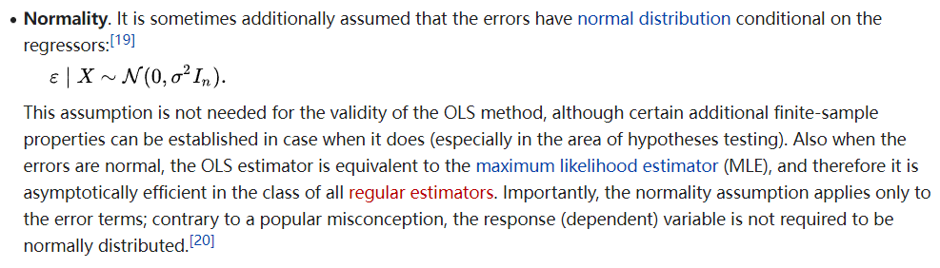
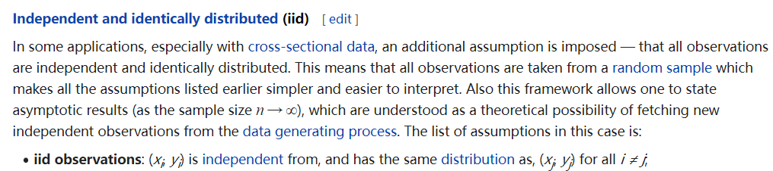
1 overview of ols - ASSUMPTION

Slide 12
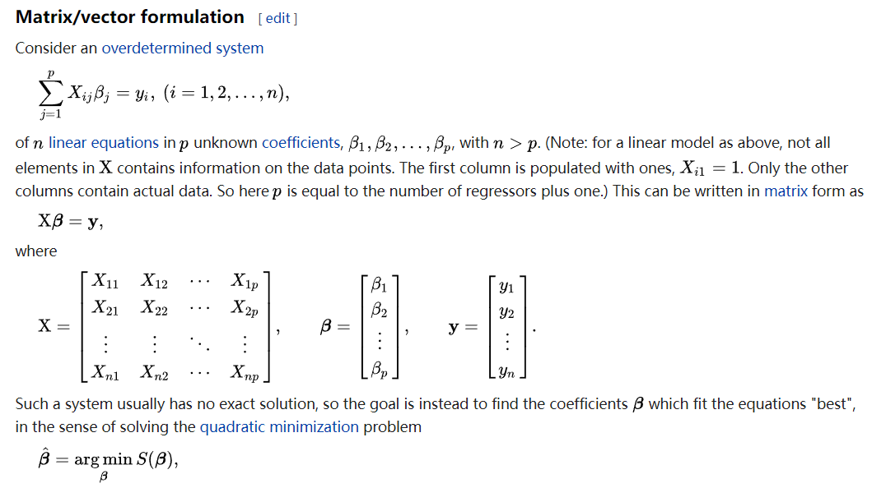
1 overview of ols - Formula

Slide 13
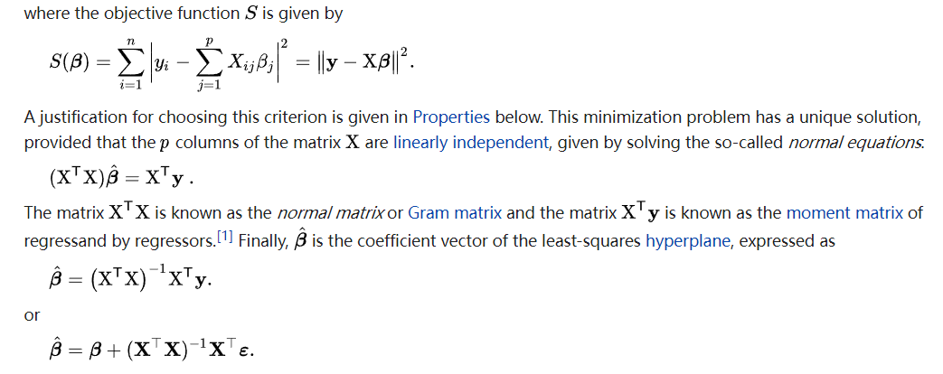
1 overview of ols - Beta

Slide 14
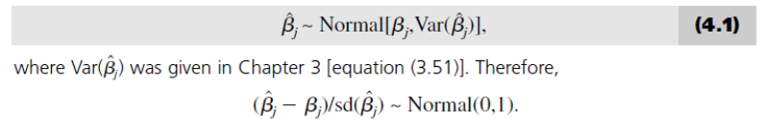
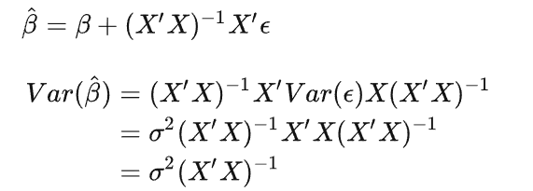
1 overview of ols - distribution

Slide 15
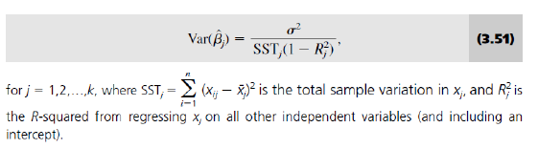
1 overview of ols - distribution

Slide 16
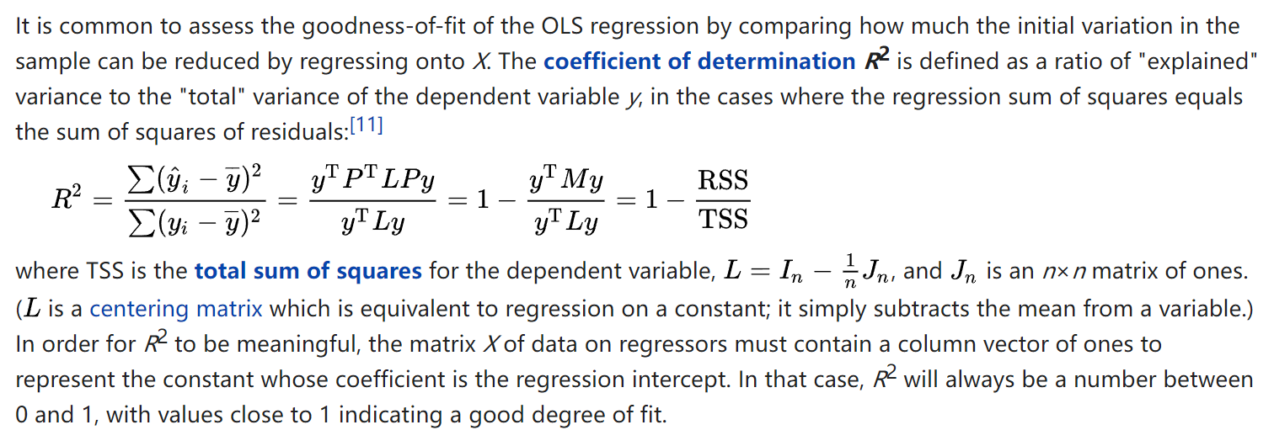
1 overview of ols – R2

Slide 17
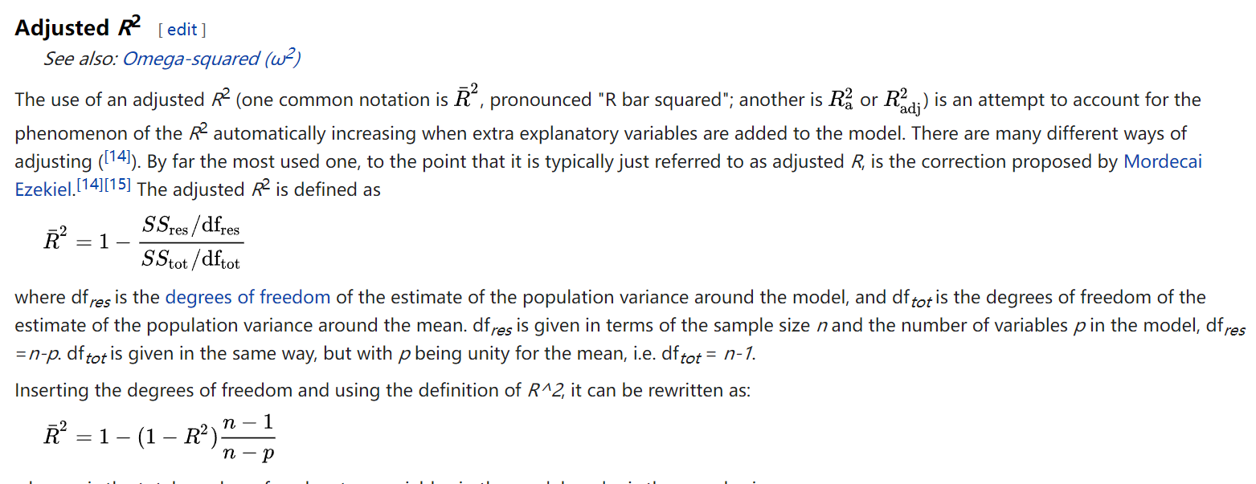
1 overview of ols – R2

Slide 18
2 FAQ of OLS
1. What does literature often control for？
2. Winsorize the data
3. VIF
4. OLS

Slide 19
2 FAQ of OLS
Combining the real question in the undergraduate and graduate thesis, we discuss the common problems using OLS.

Slide 20
2.1 Format of OLS results

Slide 21
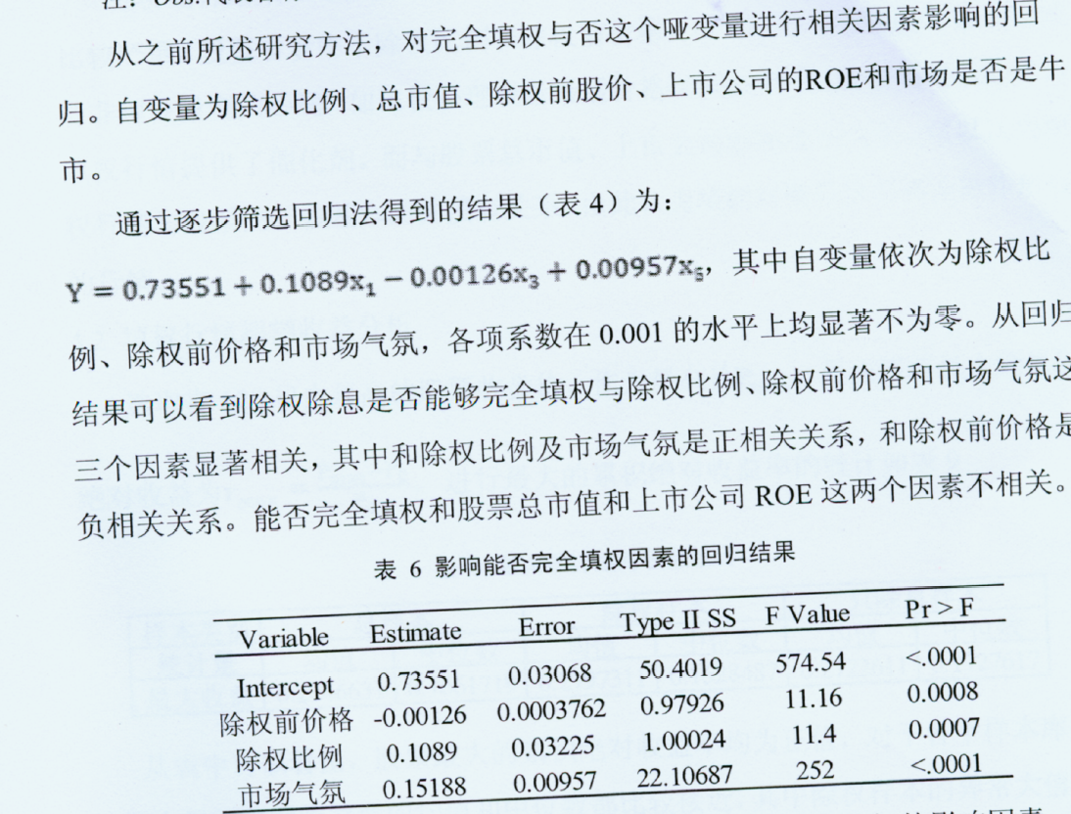

2.1 Format of OLS results

Slide 22
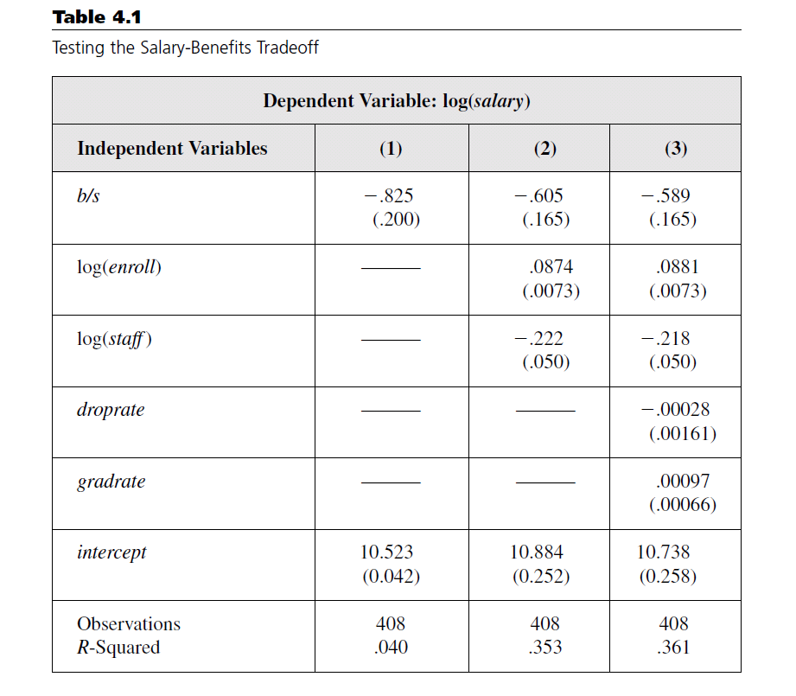
2.1 Format of OLS results
What ? How ?
Dependent variable, coefficients of the independent variable.
T value or P value or standard deviation in the parentheses.
R2 or Adjusted R2.
Observations.

Slide 23
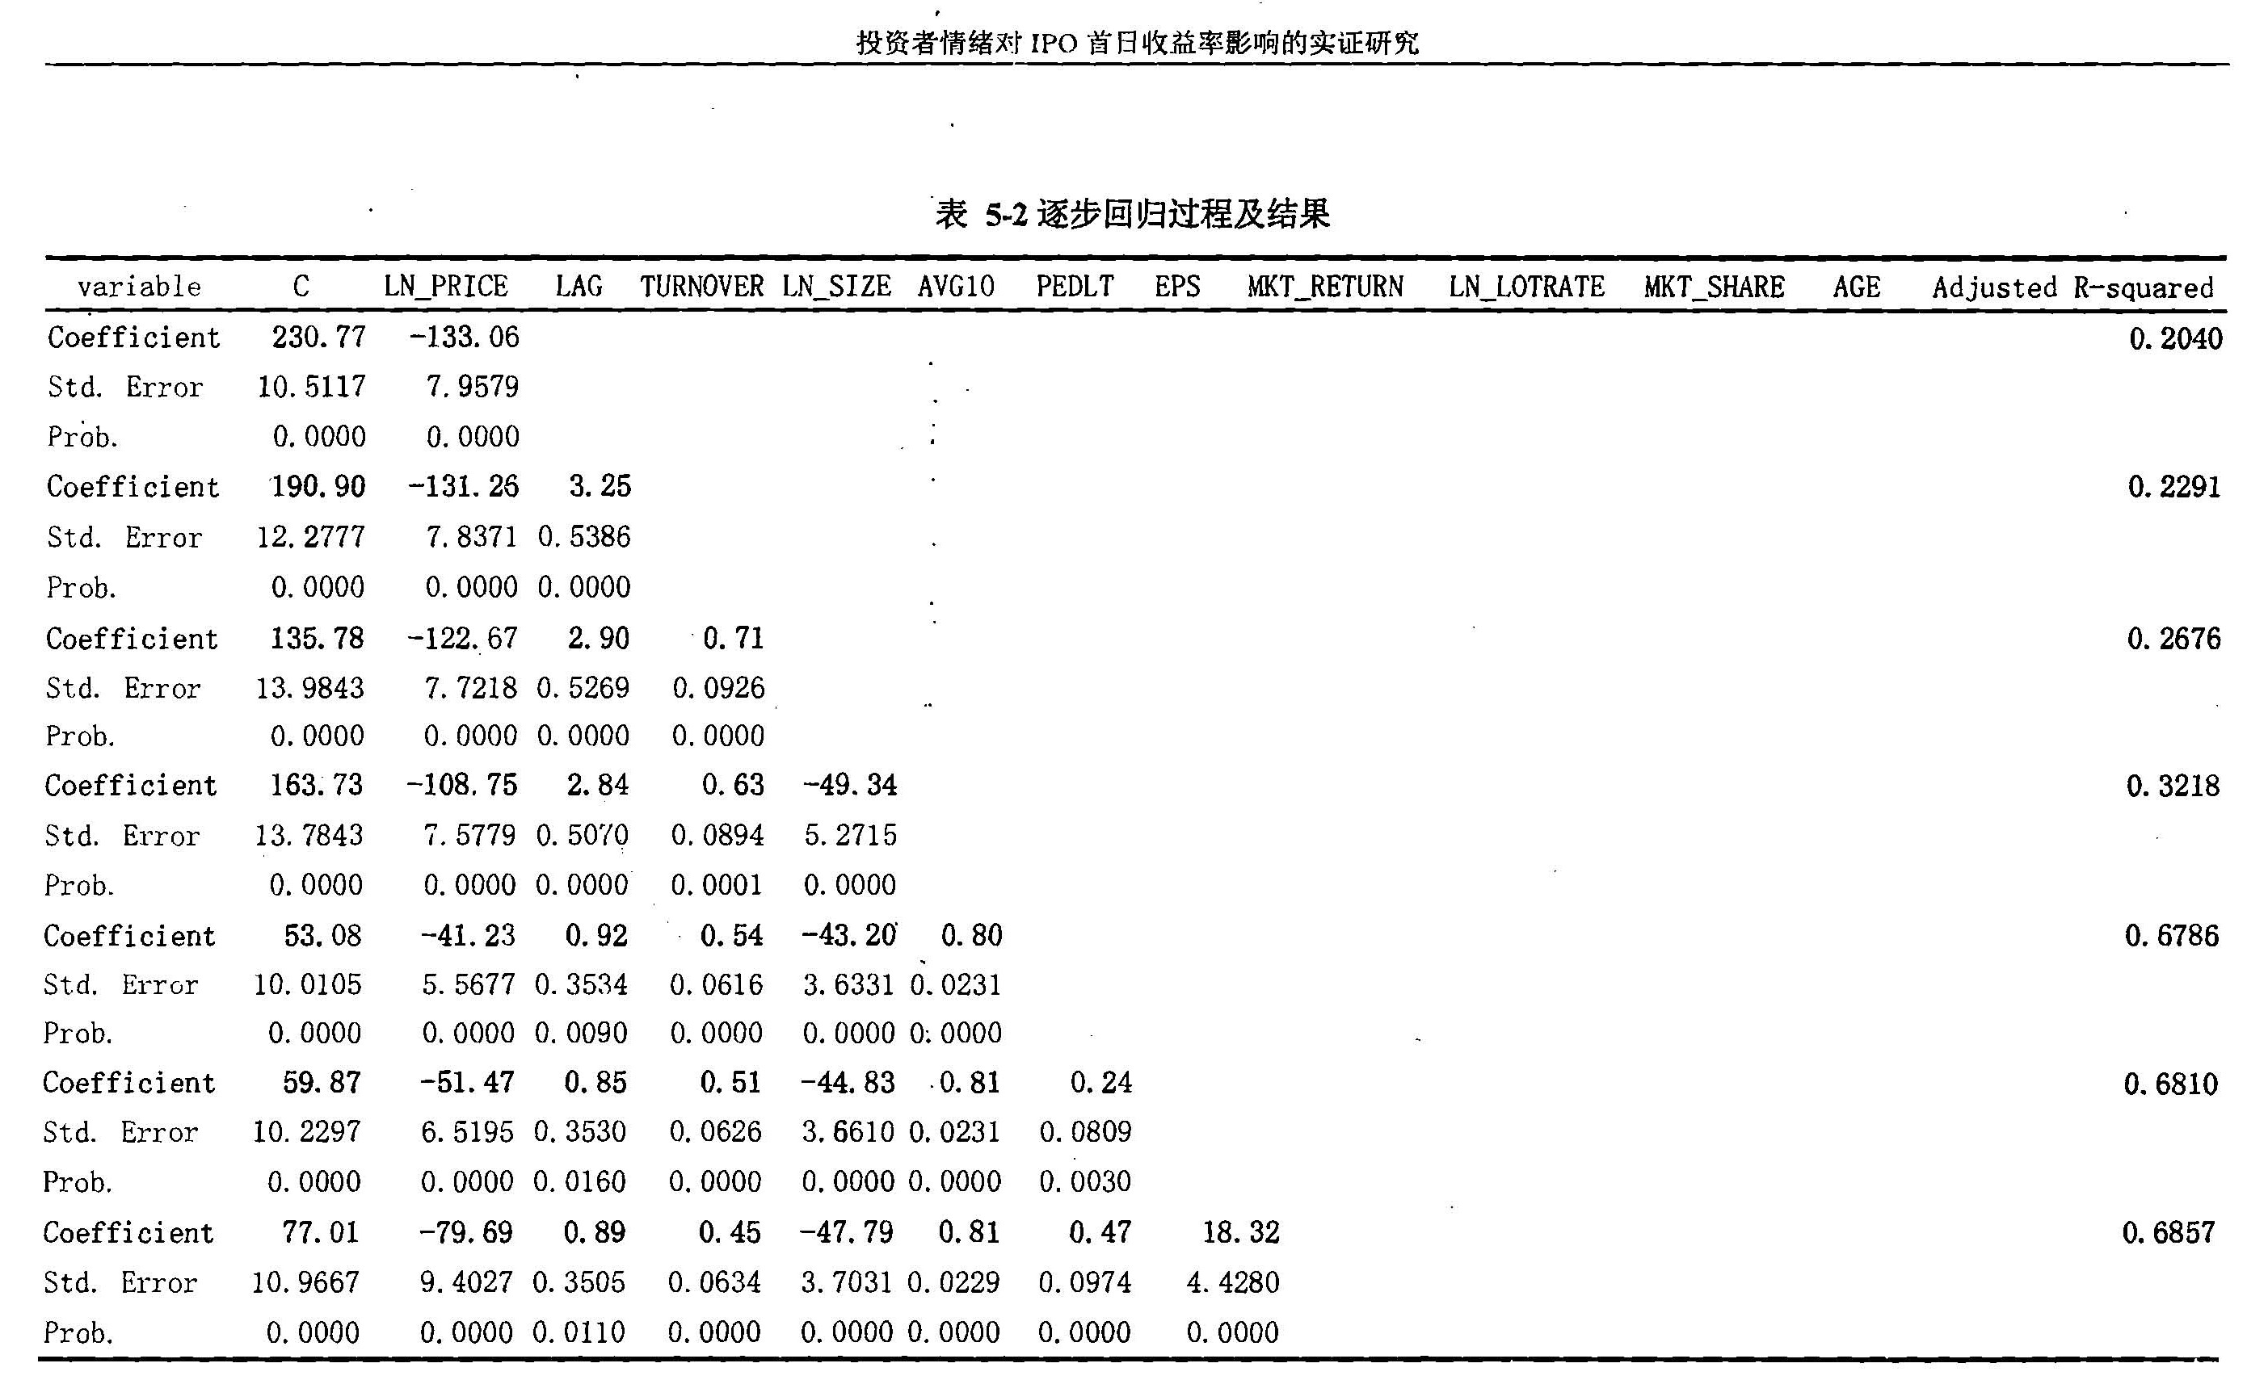
2.2 What should be added in controls

Slide 24
2.2 What should be added in controls
From the perspective or Unbiased estimation
Adding a control variable z which is uncorrelated to x？
The estimation of x will not be affected.
Adding a control variable z which is correlated to x？
The estimation of x will be affected.

Slide 25
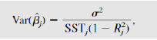
2.2 What should be added in controls
The variance of beta： The kitchen sink dilemma
Relevant controls can reduce model variance, but cause high variances through R2.
Solution：Economical principle comes first, and then Statistical principles
P1：If economic theory states that missing control z will cause endogeneity, then z should be added. (even if it is not significant)
i.e., in testing whether gender affects wage, education background should be included
P2：If economic theory states that control z has a great influence on Y, then z should be added.
i.e., in testing capital cost, debt to asset ratio must be added.
i.e., in testing investment, Tobin q must be added.
After considering economical principle, then comes statistical principles (whether beta is significant)

Slide 26
2.2 What should be added in controls
P3：If adding z does not improve R2, it is not necessary to add z.
P4：If the coefficient of z is not statistically significant, it is not necessary to add z.
P5：When considering R2 and t， “Testing down” is better than “testing up”.
But report result oppositely.

Slide 27
2.3 winsorize
Outliers
index | count | mean | std | min | 1% | 25% | 50% | 75% | 99% | max
Age | 52618 | 48.39971 | 6.940774 | 24 | 32 | 44 | 49 | 53 | 65 | 81
TotalSalary | 45596 | 765308.5 | 1159282 | 0 | 0 | 271712 | 500000 | 863700 | 5190120 | 47704000
Female | 52641 | 0.059706 | 0.236944 | 0 | 0 | 0 | 0 | 0 | 1 | 1
SharEnd | 49485 | 29169571 | 2.59E+09 | 0 | 0 | 0 | 1200 | 3545600 | 2.58E+08 | 5.73E+11
TMTP | 52641 | 1.015653 | 0.176244 | 1 | 1 | 1 | 1 | 1 | 1 | 3
IsDuality | 52641 | 0.256112 | 0.436489 | 0 | 0 | 0 | 0 | 1 | 1 | 1

Slide 28
2.3 winsorize
Python
Stata

Slide 29
In the Quadratic form, adding the primary term is needed
U-shaped and Inverted U-shape
i.e., the effect of age on income
2.3 Model setup – Nonlinear

Slide 30
2.3 Model setup – Nonlinear
In testing the U-shaped regression model, you should be careful with the axis of symmetry?
If there is only a few observations in certain side, then the significance of beta might be attributed to outliers.
X-symmetry=-b/2a
分析变量: age of house
N | mean | min | 5% | 50% | 95% | max
321 | 18 | 0 | 0 | 4 | 81 | 199

Slide 31

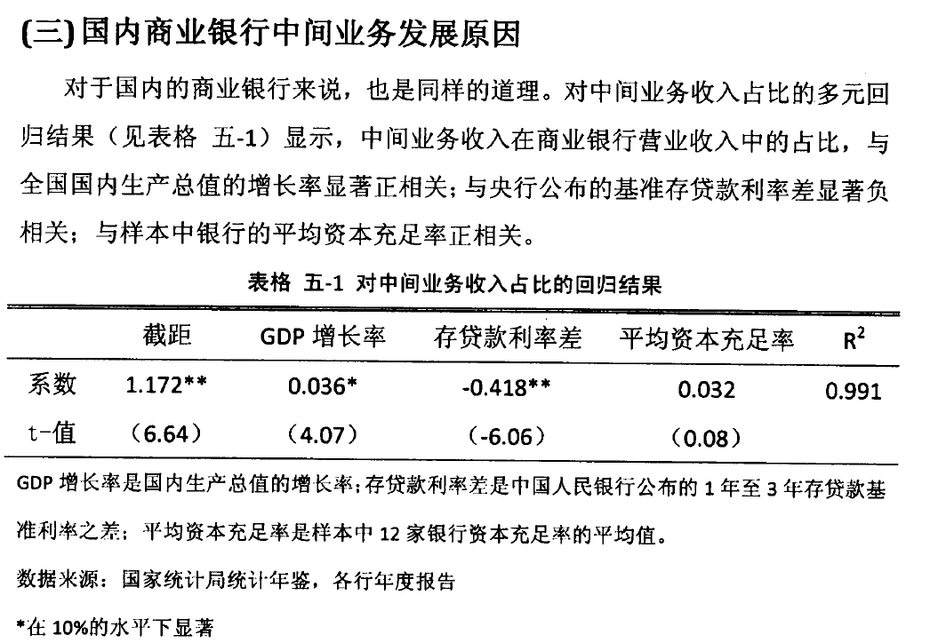
2.4 r2

Slide 32
2.4 r2
How large is R2？
It varies with the subject of your study.
If your R2 is greatly different from the literature. Highly likely to be wrong.
R2 between models. In most cases, not comparable.
But in testing the same Y in different models, it is comparable.

Slide 33
2.5 Collinearity
Multicollinearity occurs when independent variables in a regression model are correlated. This correlation is a problem because independent variables should be independent. If the degree of correlation between variables is high enough, it can cause problems when you fit the model and interpret the results.
Testing for Multicollinearity with Variance Inflation Factors (VIF)
If you can identify which variables are affected by multicollinearity and the strength of the correlation, you’re well on your way to determining whether you need to fix it. Fortunately, there is a very simple test to assess multicollinearity in your regression model. The variance inflation factor (VIF) identifies correlation between independent variables and the strength of that correlation.

Slide 34
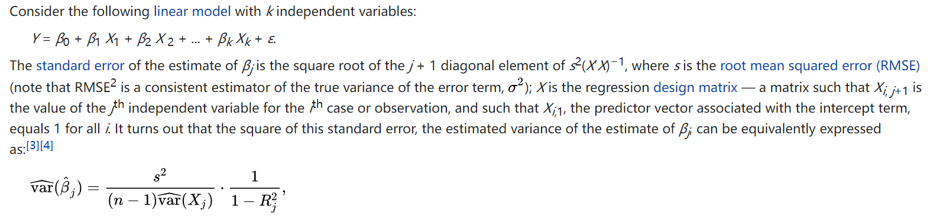
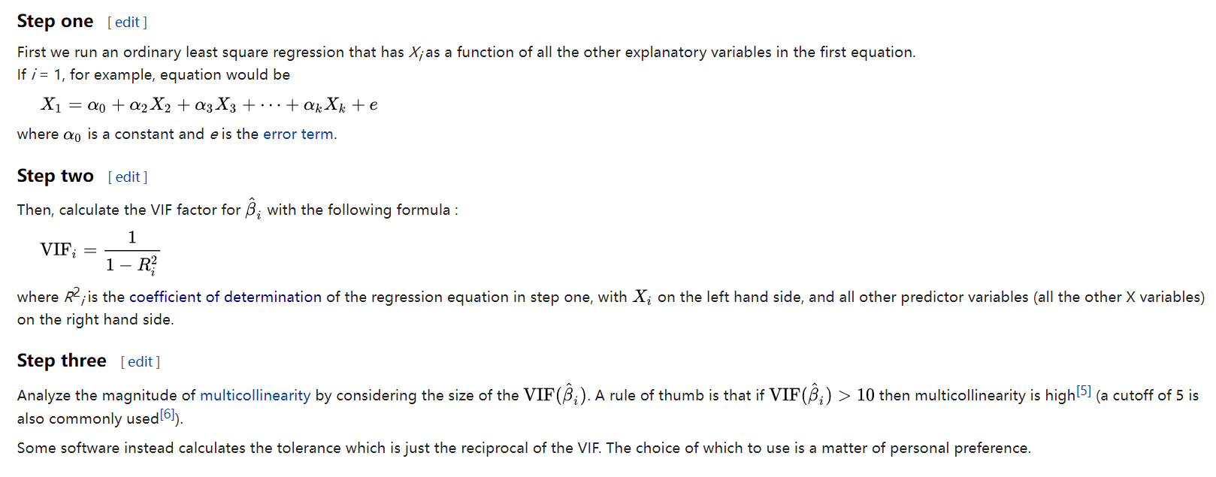
2.5 Collinearity

Slide 35
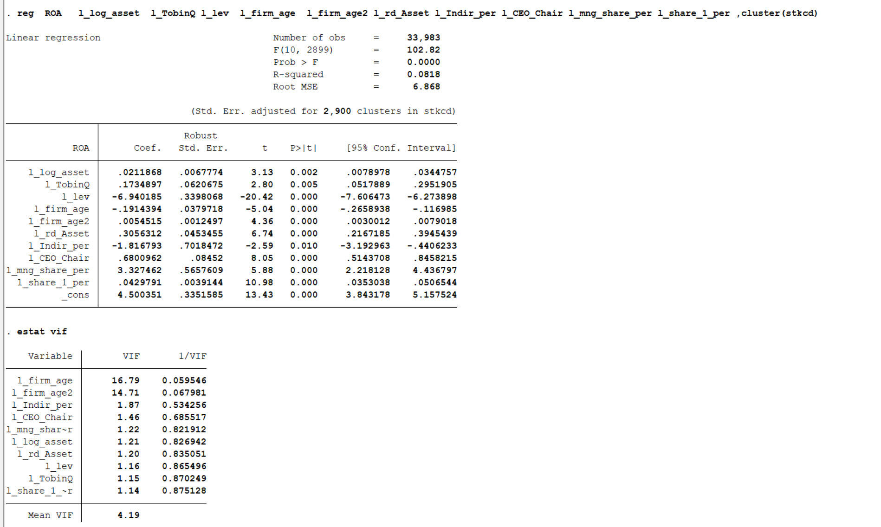
2.5 Collinearity -vif

Slide 36
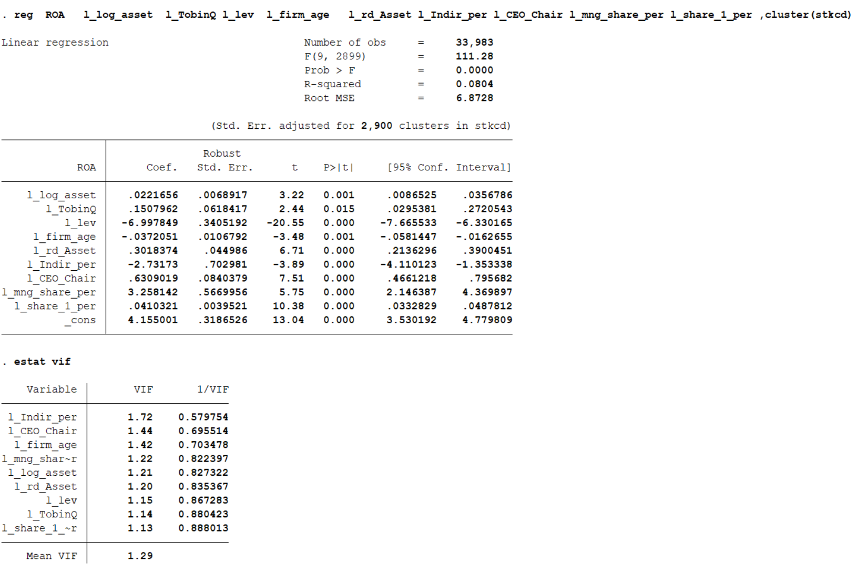
2.5 Collinearity -vif

Slide 37
3 An example
1. Merge Data
2.Standardize
3. Summary
4. VIF
5. OLS

Slide 38
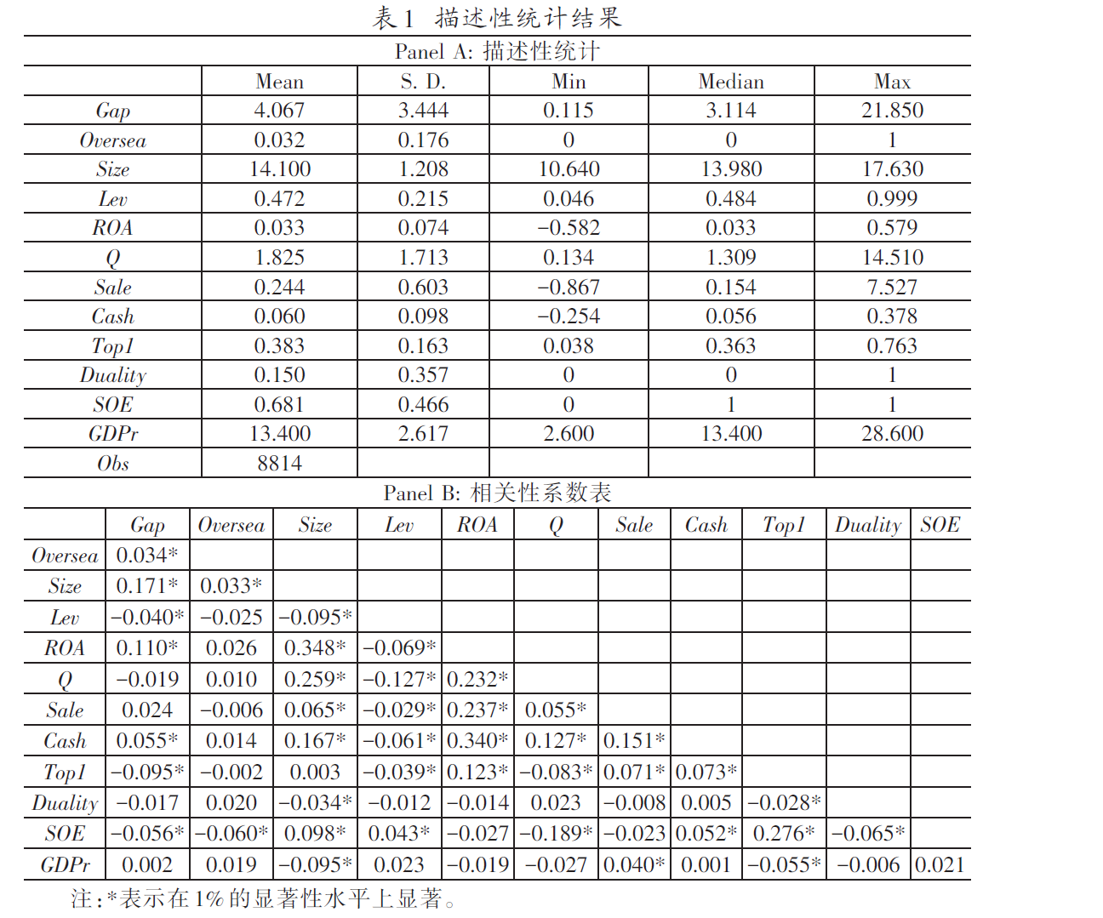
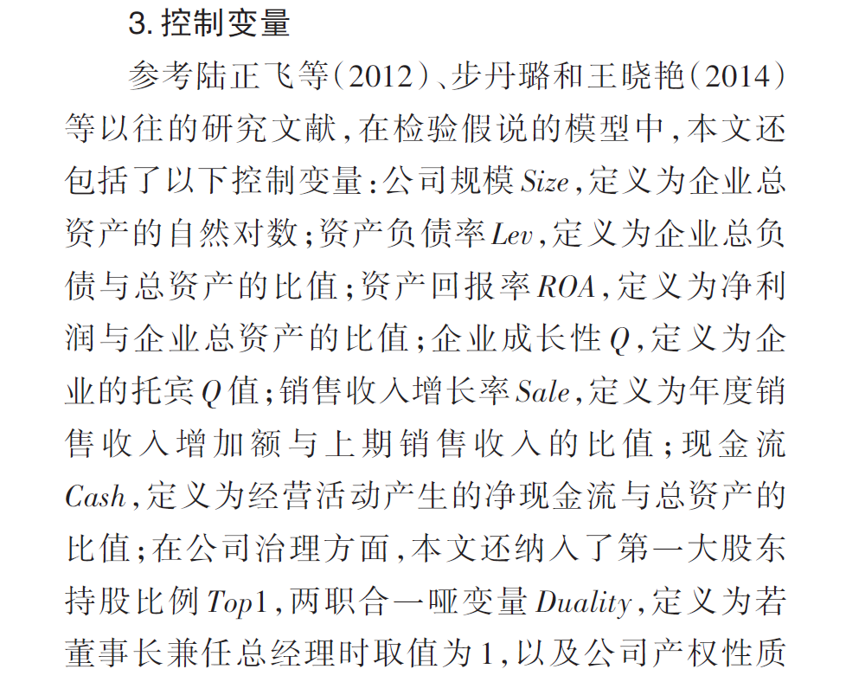
3.1 Merge data
[1]柳光强,孔高文.高管海外经历是否提升了薪酬差距[J].管理世界,2018,34(08):130-142.

Slide 39
3.1 Merge data
1 Salary
2 Firm level financial data
(Size, Lev, ROA, Tobin Q)
3 Board structure
(CEO_Chair, Female_Board)

Slide 40
3.2 Standardize
Log Form
Difference
Winsorize
……

Slide 41
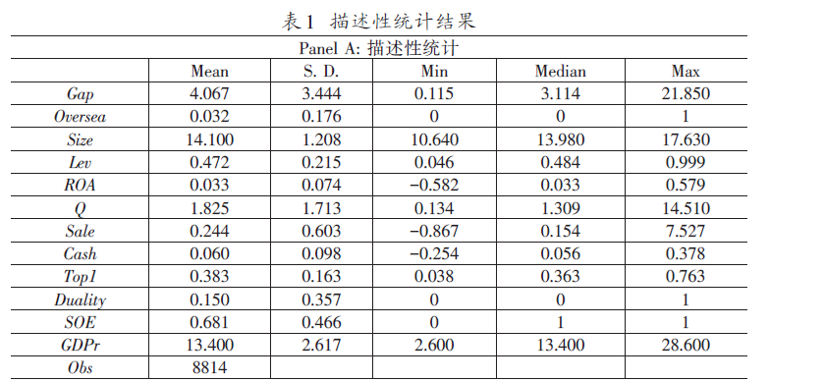
3.3 summary
[1]柳光强,孔高文.高管海外经历是否提升了薪酬差距[J].管理世界,2018,34(08):130-142.

Slide 42
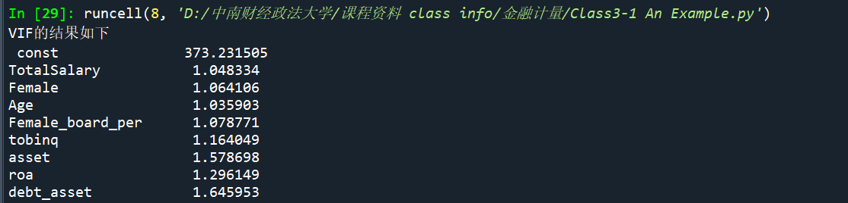
3.4 vif

Slide 43
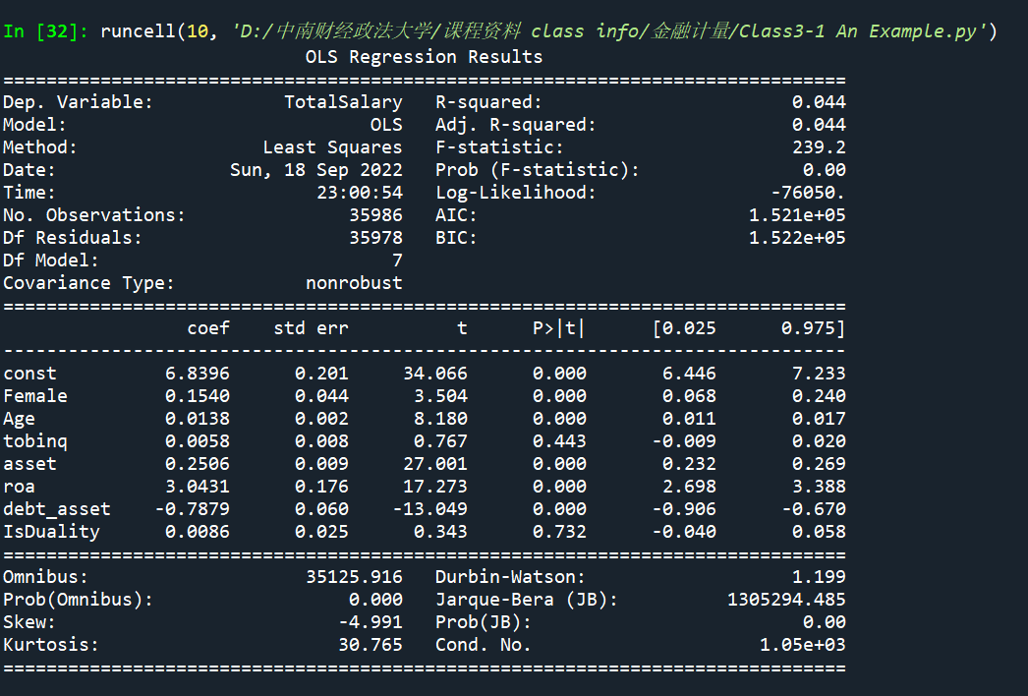
3.5 ols

Slide 44
4 event study intro
An event study is a statistical method to assess the impact of an event on the value of a firm. For example, the announcement of a merger between two business entities can be analyzed to see whether investors believe the merger will create or destroy value. The basic idea is to find the abnormal return attributable to the event being studied by adjusting for the return that stems from the price fluctuation of the market as a whole. The event study was invented by Ball and Brown (1968).
As the event methodology can be used to elicit the effects of any type of event on the direction and magnitude of stock price changes, it is very versatile. Event studies are thus common to various research areas, such as accounting and finance, management, economics, marketing, information technology, law, political science, operations and supply chain management.

Slide 45
4 event study intro
The procedure of event study
Define the event
Data collection
Estimate raw and abnormal (adjusted) return
Statistical test and/or regression analysis

Slide 46
4.1 Define the event
What event and when? Notes when defining events :
If the events are of the same kind, the direction of market reaction should be considered.
For example, in M&A research, the reactions of the acquirer and the acquiree may be different, so we should only look at the acquirer (or the acquiree).
Analysts' reports, which have been revised up and down, should be separated.
The change of events relative to the stock market price is exogenous;
Whether the event affects the stock price or triggers the event.
Announcement of abnormal fluctuation of stock price?
Stock price trigger event, Or the other way around?
CEO turnover? Either direction is possible
For endogenous event, can we do event study?
Yes and no, because the explanation is different. The result shows correlation, not causality.

Slide 47
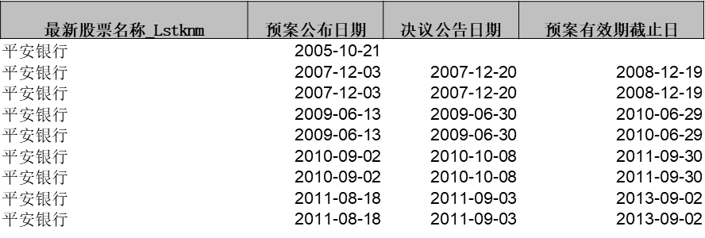
4.1 Define the event
Event Date：1. The time when the event happens; 2. The event known by the market.
“预案公布日期”（可能还有董事会会议日期）可以是事件的时间。它们对应的事件主要考察是“市场猜公司为什么增发”
“决议公告日期”也可以是事件的时间。它们对应的事件主要“预案公告是有部分人没注意到，从而还有信息含量”
“预案有效截止日”对应的事件是“增发导致市场的流动性变化”
大部分研究关注的是事件为什么发生，即市场知道的时间，这里就是“预案公布日期”
Event Window
Because of possible information leak, event window usually starts at –5, (-5, 10)

Slide 48
4.2 collecting data
Data needed:
-- event date
-- returns
-- factors will be used to estimate normal return

Slide 49
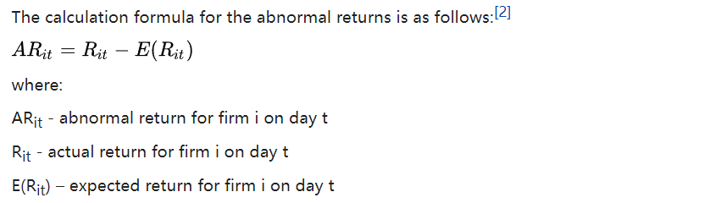
4.3 abnormal return estimation
Cumulative abnormal return, or CAR, is the sum of all abnormal returns.

Slide 50
4.3 abnormal return estimation

Slide 51
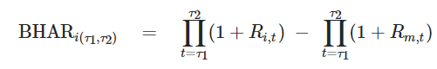
4.3 abnormal return estimation
Cumulative abnormal return(CAR)
is the sum of all abnormal returns.
2. Buy-and-hold abnormal return (BHAR)
The BHAR is based on this principle and calculates abnormal returns by deducting the normal buy-and-hold return from the realized buy-and-hold return.

Slide 52
4.3 abnormal return estimation
Model used for normal return estimation （factor model）:
-- constant mean return
-- market model
-- Fama-French 3 factor model
-- extended 3 factor model, adding momentum factor
-- market-adjusted model
-- size-industry portfolio adjusted model
Data used to estimate normal return:
-- Event window and estimation window cannot overlap
-- Estimation window usually ends at –10 because of possible information leak.
-- The length of estimation window?
-- enough to estimate the normal return model.
-- around 200

Slide 53
4.4 Statistical test and regression
Whether there is abnormal return: t-test the calculated abnormal return at each time point directly
One day abnormal return
if there is significant abnormal return on - 3 days, it means that:
Information leaked in advance
There is a problem with the event date you defined
If there is significant abnormal return on day + 2 and the response is consistent with that on day 0, it means that:
Lag reaction
If there is a significant abnormal return on day + T, which is opposite to the reaction on day 0, it means that:
Reversal reactionThe previous reaction was “noise” or sentimental factors
Testing and drawing picture of accumulated abnormal income

Slide 54
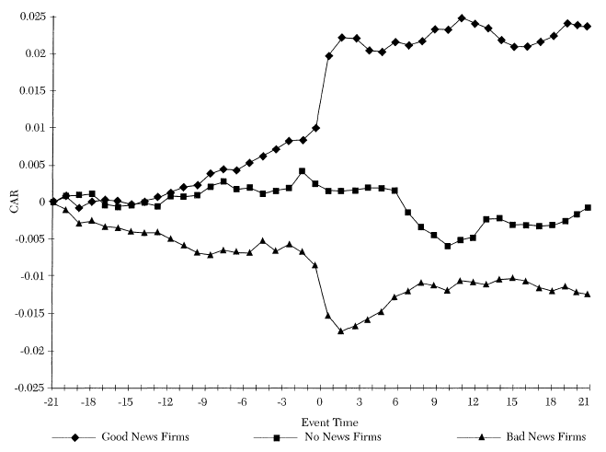
4.4 Statistical test and regression

Slide 55
4.4 Statistical test and regression
The limitation of t test.
correlation of AR should not exist
Macro event:
i.e., interest rate change of central bank
Only correlation
Overlapping problem of different event date.
What if events happens in the consecutive days？
Causing correlation of AR between different event dates.
Bootstrapping
pseudo-portfolio
Regression models(Fama-Macbeth regression; DID)
Explore and eliminate other factors that affects AR.
T test first, then comes other tests.

